Slide 1

Introducing DesignDeck: Design & Code Upload Platform
DesignDeck is a new platform to upload design and code. We use modern technologies for a seamless experience.

Slide 2

Tech Stack Deep Dive: Modern Technologies
Frontend
Backend
React for UI. Tailwind CSS for styling.
Node.js with Express.js. MongoDB with Mongoose.

Slide 3
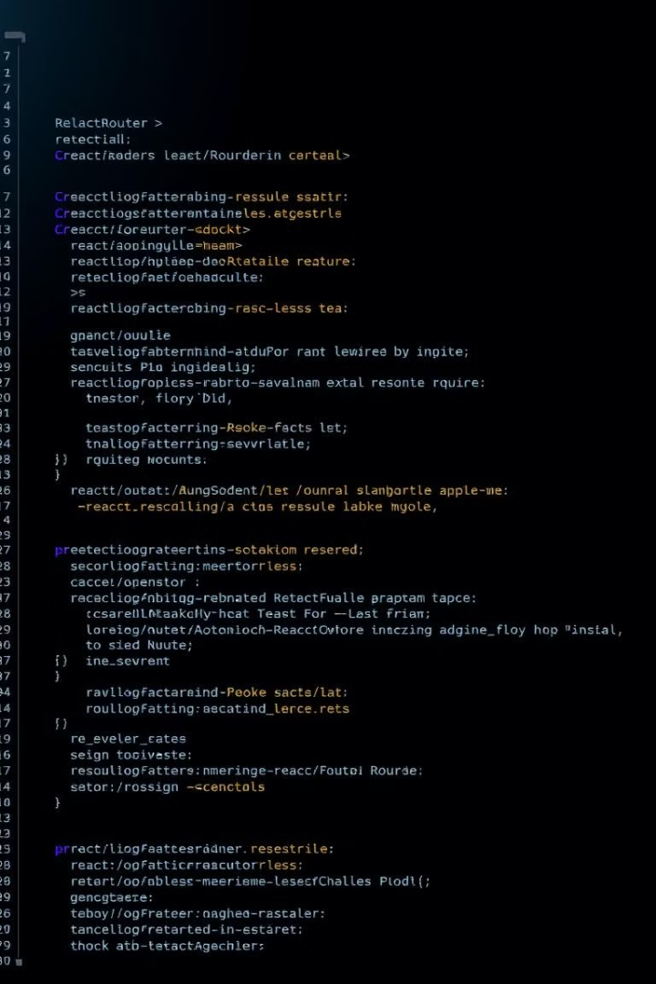
Frontend Architecture: Key Components
1
React Router
2
Axios
Enables smooth navigation.
Handles API requests.
3
UI Components
Reusable and modular.

Slide 4





Backend Architecture: Robust and Secure
Node.js
Express.js
Mongoose
Scalable runtime.
Manages routes.
Data modeling.
JWT
Authentication.

Slide 5




File Upload System: Cloud Storage
Multer
Handles uploads.
Cloudinary API
Stores files securely.
Optimized Images
Fast loading times.

Slide 6
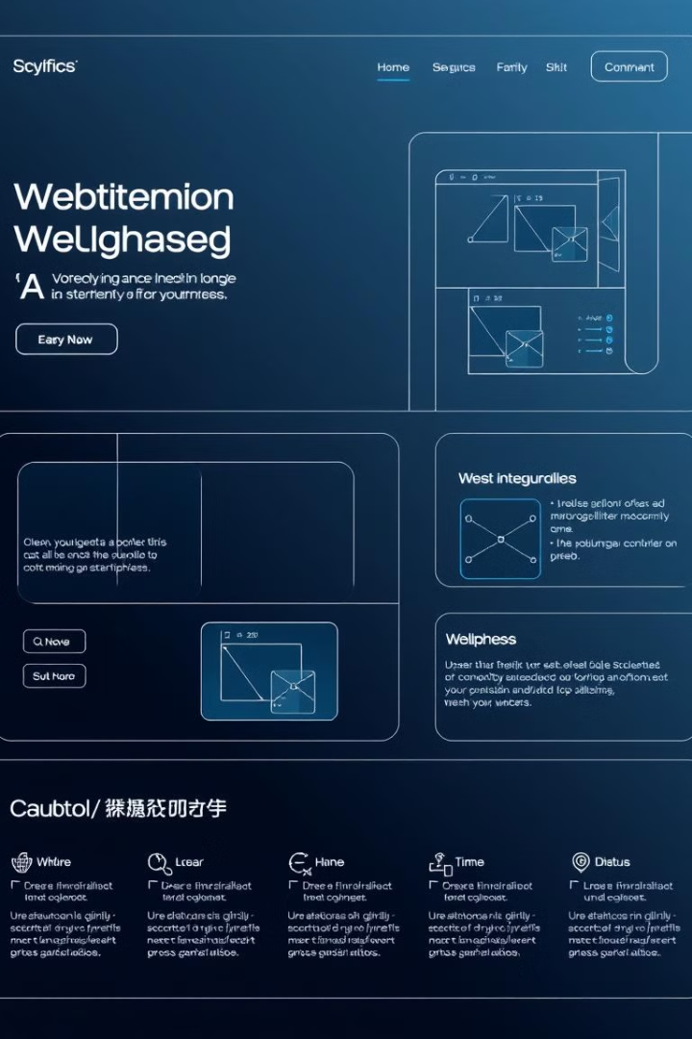
UI Pages: DesignDeck Experience
Landing Page
First impression.
Sign-in/Sign-up
Secure access.
Dashboard
Project overview.
Project View
Detailed project view.

Slide 7
UI Pages: DesignDeck Experience
1
Upload Page
2
Profile Page
3
Contact Us Page
The upload page has a clean and intuitive design. Drag and drop files for easy uploading.
The profile page allows users to manage their account. View personal information and settings.
The contact us page has a simple form. Users can submit inquiries and feedback.

Slide 8
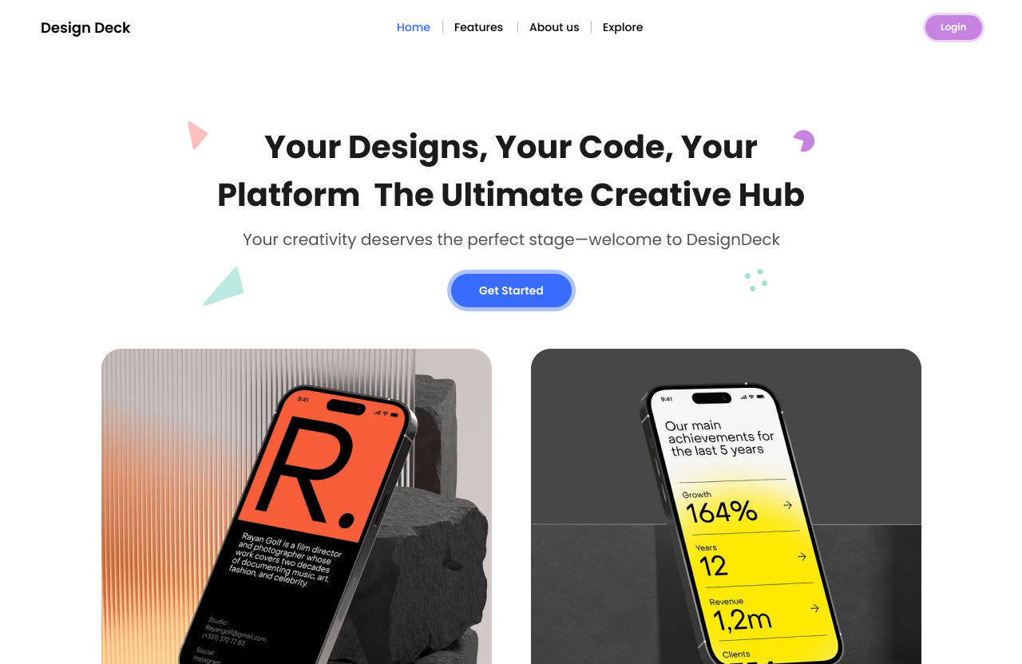
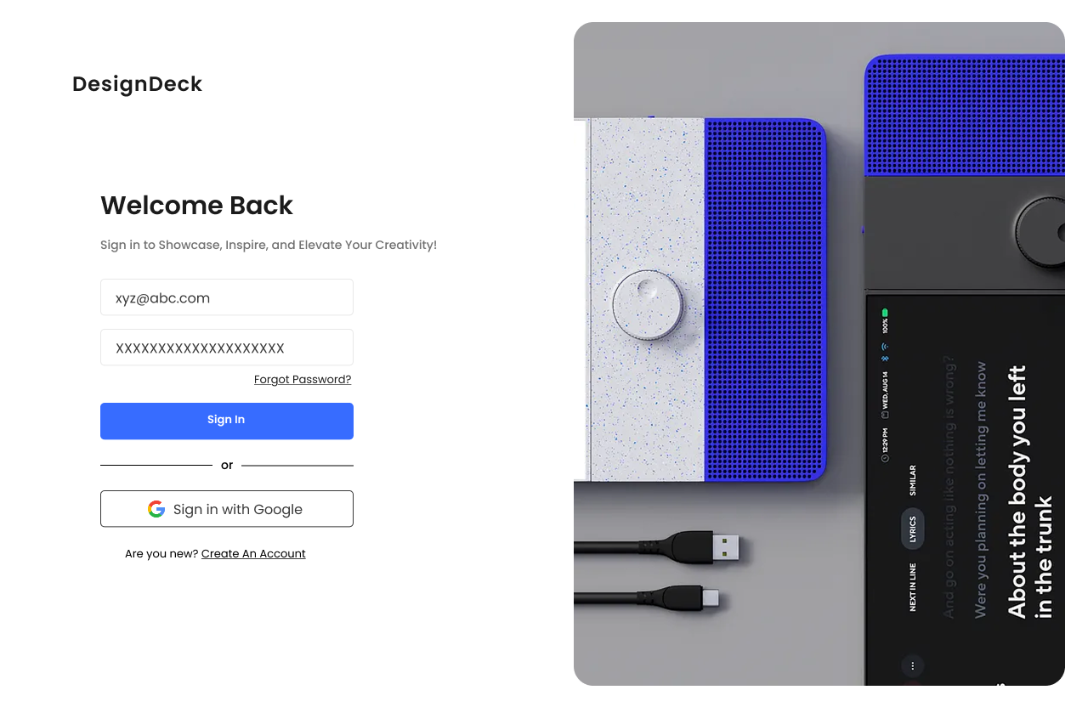
User Interface Screenshots: Design in Action
Landing page
Sign in Page

Slide 9
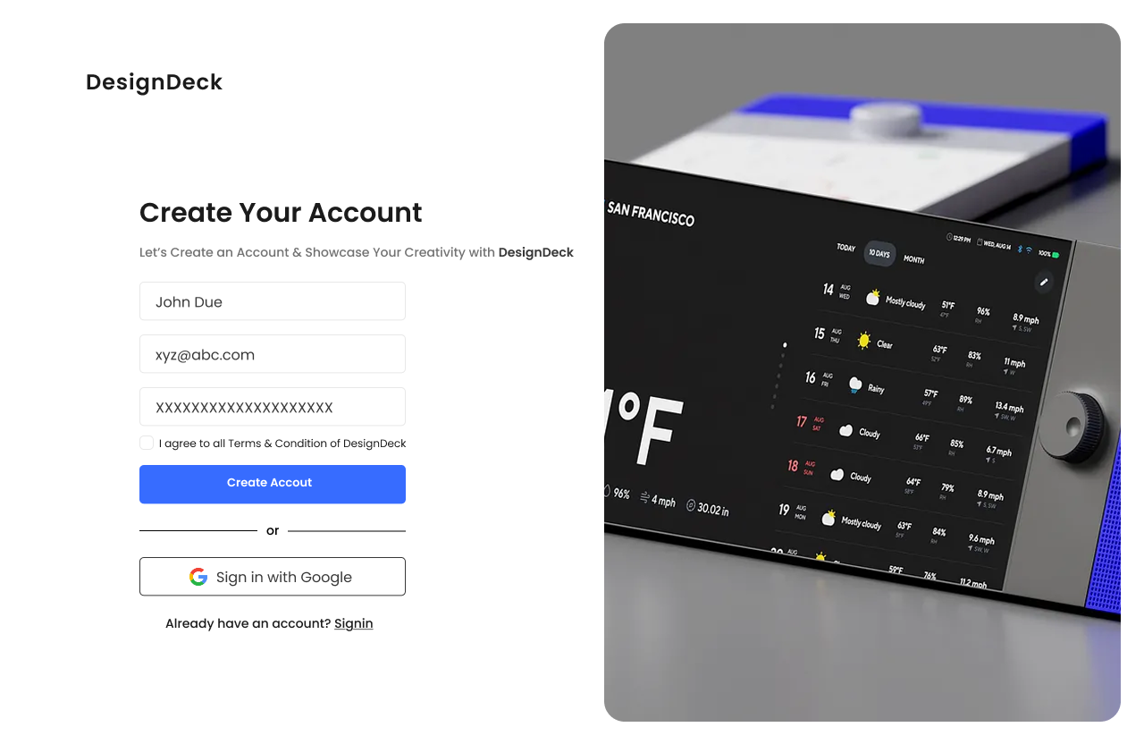
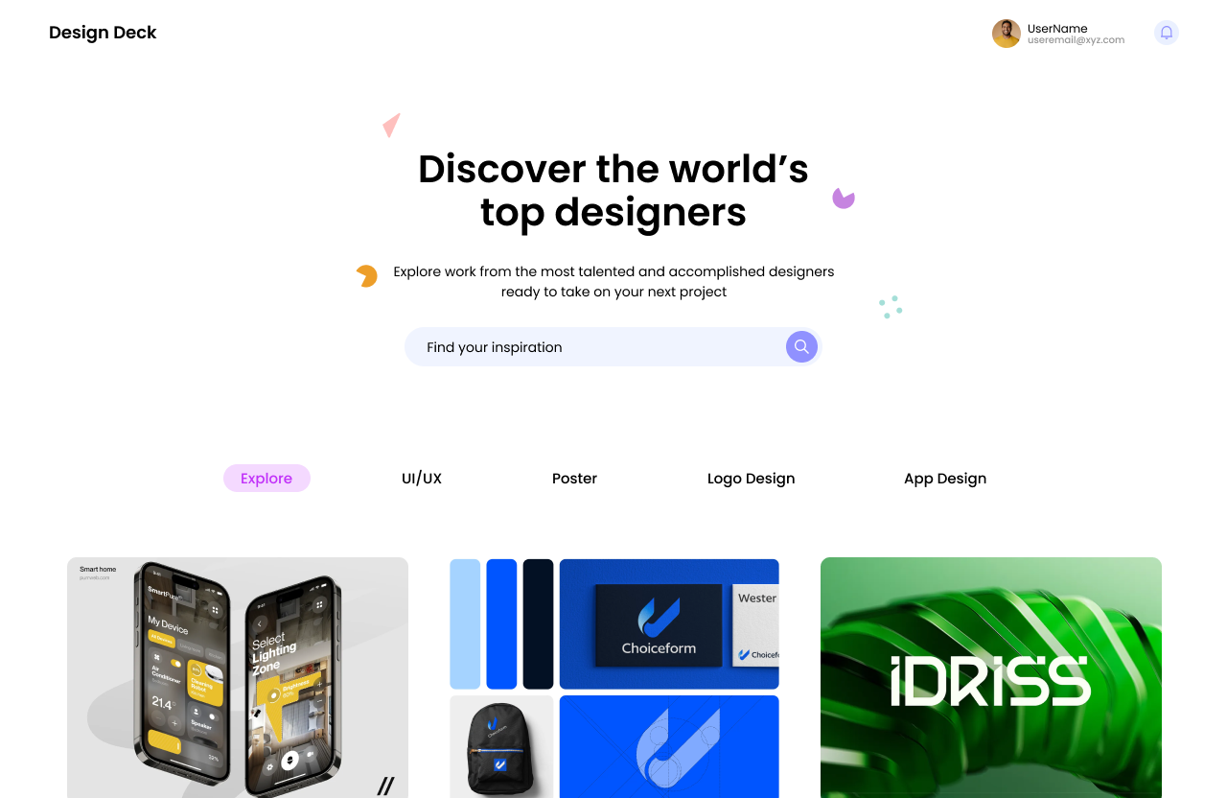
User Interface Screenshots: Design in Action
Sign up Page
Dashboard

Slide 10
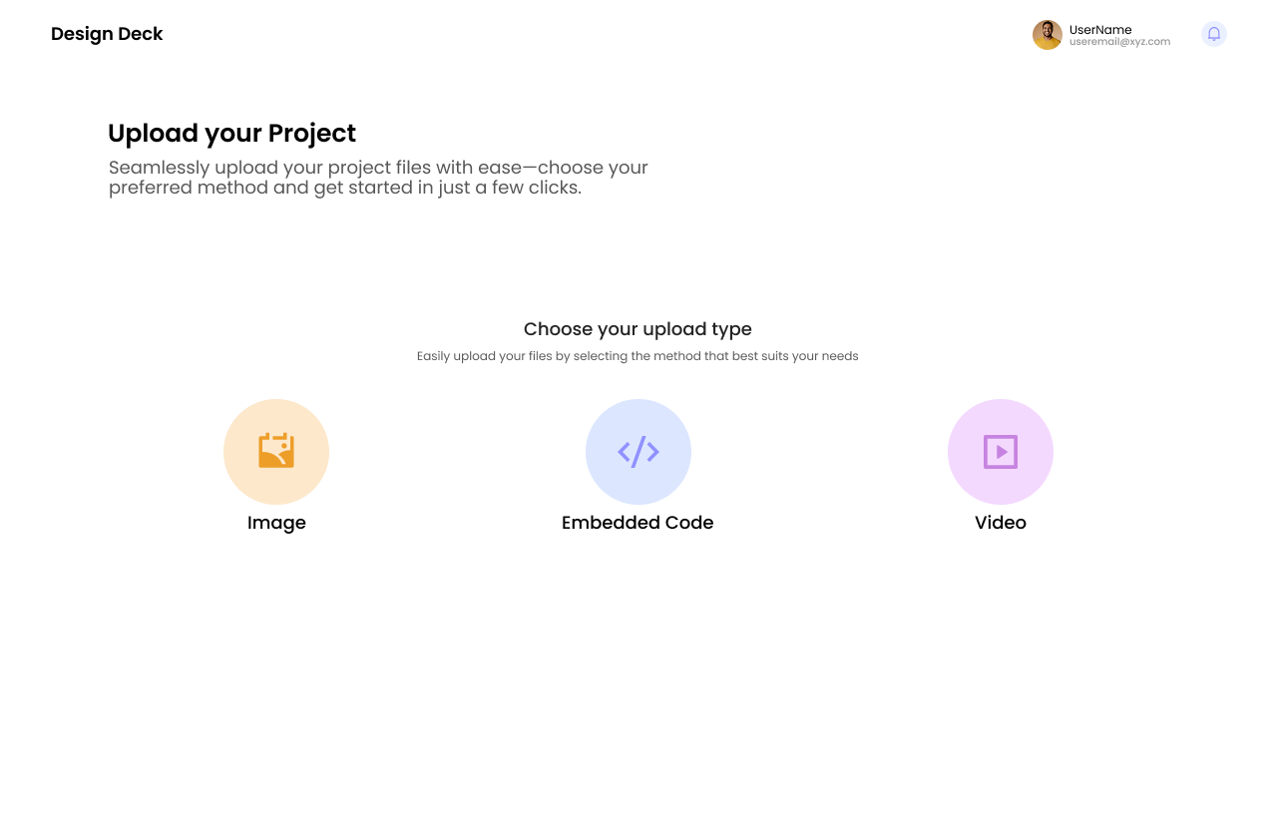
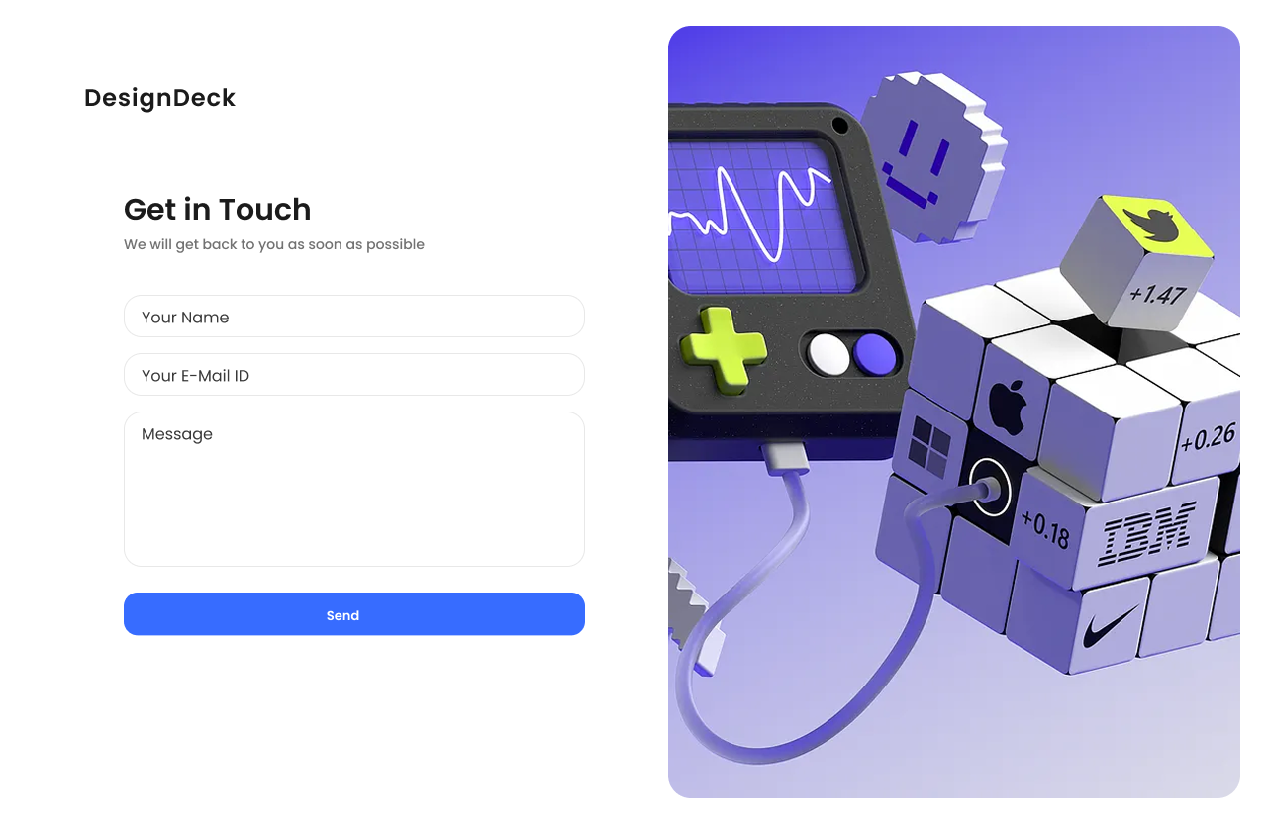
User Interface Screenshots: Design in Action
Upload Page
Contact us

Slide 11

DesignDeck: Future Plans and Beta
1
Beta Launch
Initial feedback.
2
Feature Updates
Improved features.
3
Community Growth
Expanding base.
4
Full Release
Ready for users.

